Slide 1
Car purchasing & prediction
CAPSTONE PROJECT
Presented By:
Manikandan S
9513- Jayaraj Annapackiam CSI College Of Engineering
B.E Mechanical Engineering

Slide 2
OUTLINE
Problem Statement
Proposed System/Solution
System Development Approach
Algorithm & Deployment
Result
Conclusion
Future Scope
References

Slide 3
Problem Statement
Develop an online platform that facilitates the buying and selling of used cars. The platform should allow users to search for cars based on various criteria such as make, model, year, price range, and mileage. Users should be able to view detailed information about each car listing, including photos, specifications, and seller contact information. The platform should also include features for sellers to create listings, set prices, upload photos, and communicate with potential buyers. Additionally, implement a secure payment system to facilitate transactions between buyers and sellers, ensuring transparency and trust throughout the process. The goal is to create a user-friendly and efficient platform that simplifies the car buying and selling experience for both parties.

Slide 4
Proposed Solution
User Registration and Authentication: Allow users to create accounts and authenticate securely.
Search and Filter Functionality: Implement a robust search engine that enables users to search for cars based on make, model, year, price range, mileage, and other relevant criteria.
Car Listings: Provide a platform for sellers to create detailed listings for their cars. Include fields for specifications such as make, model, year, mileage, condition, price, photos, and any additional features.
Seller Verification: Implement a verification process for sellers to ensure credibility and trustworthiness. This can include verifying identity, contact information, and ownership documentation.
Buyer-Seller Communication: Enable communication channels such as messaging or chat to facilitate discussions between buyers and sellers regarding car details, negotiations, and scheduling viewings or test drives.
Secure Payment Gateway: Integrate a secure payment gateway to enable online transactions. Provide options for various payment methods such as credit/debit cards, bank transfers, or escrow services.
Rating and Review System: Allow buyers and sellers to rate and review each other based on their experiences. This helps build trust and transparency within the community.
Mobile-Friendly Interface: Develop a responsive and mobile-friendly interface to ensure accessibility and ease of use across devices such as smartphones and tablets.
Documentation and Legal Compliance: Ensure that the platform complies with relevant regulations and includes features for documenting transactions, generating invoices, and handling legal aspects such as sales contracts and warranties.
Customer Support: Offer dedicated customer support to assist users with any inquiries, issues, or disputes that may arise during the buying or selling process.

Slide 5
System Approach
Requirement Gathering: Begin by gathering detailed requirements from stakeholders including buyers, sellers, and administrators. Identify key features, user roles, security requirements, and integration needs.
Design and Architecture:
Database Design: Design a database schema to store information about cars, users, transactions, ratings/reviews, and other relevant data.
System Architecture: Choose a scalable and secure system architecture (e.g., microservices, monolithic) based on the project's requirements and expected traffic.
Database Implementation:
Database Management System (DBMS): Choose a DBMS (e.g., MySQL, PostgreSQL, MongoDB) based on data storage and retrieval requirements.
Data Modeling: Implement the database schema designed earlier and ensure proper indexing, normalization, and data integrity.
Testing:
Unit Testing: Write and execute unit tests to ensure individual components (frontend, backend, APIs) work as expected.
Integration Testing: Conduct integration tests to validate interactions between different system modules.

Slide 6
Algorithm & Deployment
Car Purchasing Algorithm:
User Registration and Authentication:
Users register on the platform and authenticate their accounts.
Authentication can be achieved using email verification, phone number verification, or social media login.
Search and Filter Cars:
Users search for cars based on criteria such as make, model, year, price range, mileage, location, and more.
Implement a filtering mechanism to refine search results according to user preferences.
View Car Listings:
Display detailed listings of cars that match the user's search criteria.
Include information like car specifications, photos, seller contact details, price, and additional features.
Seller Interaction:
Allow users to interact with sellers through messaging or chat functionalities.
Facilitate negotiations, scheduling test drives, and asking questions about the car.
Secure Payment Processing:
Integrate a secure payment gateway for users to make payments for purchasing cars.
Ensure encryption and compliance with payment industry standards for secure transactions.
Transaction Management:
Manage the transaction process, including generating invoices, handling refunds, and updating transaction status.
Implement features for buyers to leave reviews and ratings for sellers based on their experiences.

Slide 7
Deployments
Infrastructure:
Choose a scalable and reliable infrastructure for deployment, such as cloud hosting services like AWS, Azure, or Google Cloud.
Consider factors like server capacity, bandwidth, database performance, and geographic distribution to optimize system performance.
Containerization:
Use containerization technologies like Docker to package the application and its dependencies into containers for easier deployment and management.
Load Balancing:
Implement load balancing mechanisms to distribute incoming traffic evenly across multiple servers or instances, ensuring high availability and performance during peak usage periods.
Database Management:
Use a robust database management system (DBMS) such as MySQL, PostgreSQL, or MongoDB to store and manage data efficiently.
Configure database backups, replication, and failover mechanisms to ensure data integrity and availability.
Security Measures:
Implement stringent security measures to protect user data, transactions, and sensitive information.
Use HTTPS for secure communication, implement firewalls, intrusion detection systems, and regularly update security patches.

Slide 8
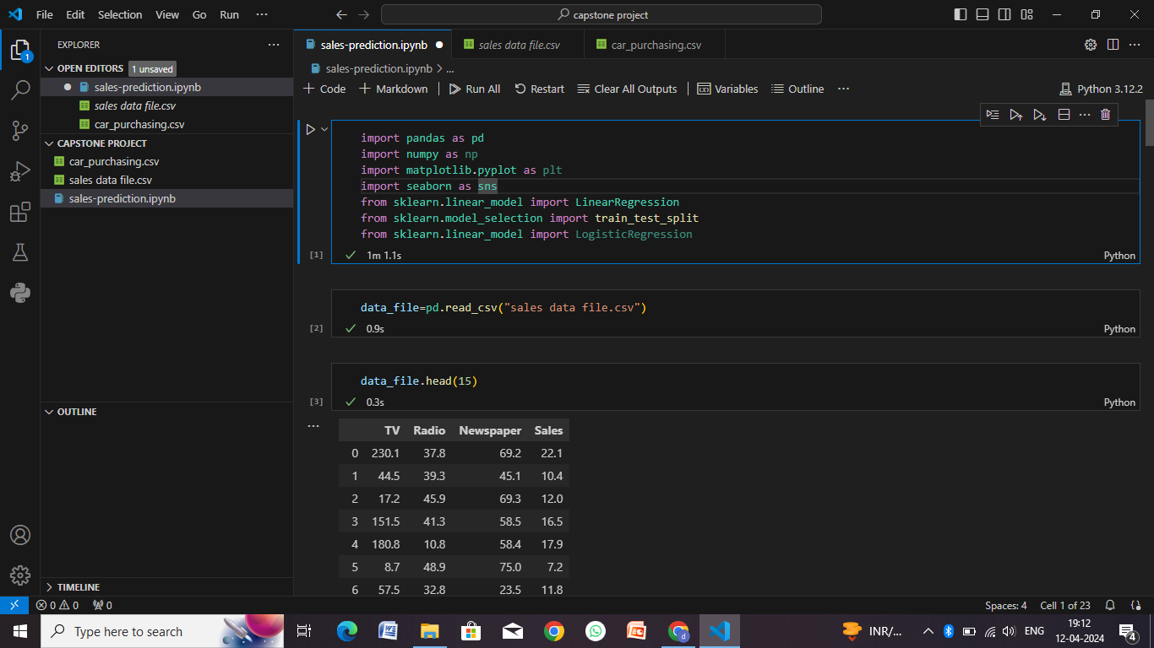
Result

Slide 9
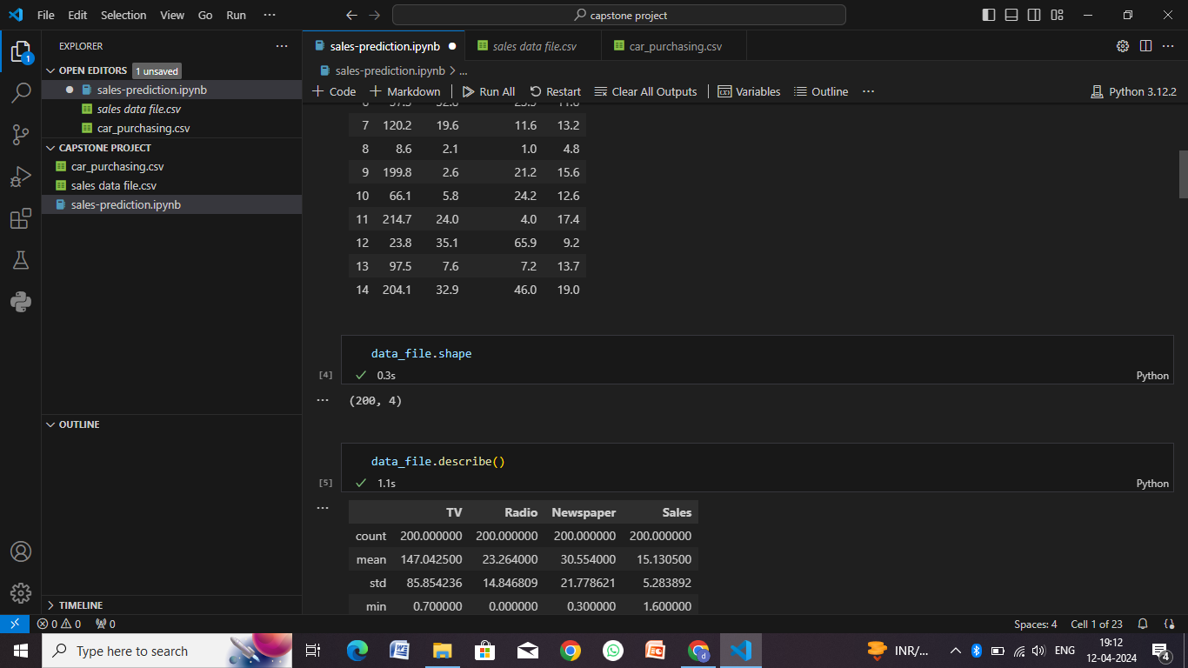

Slide 10
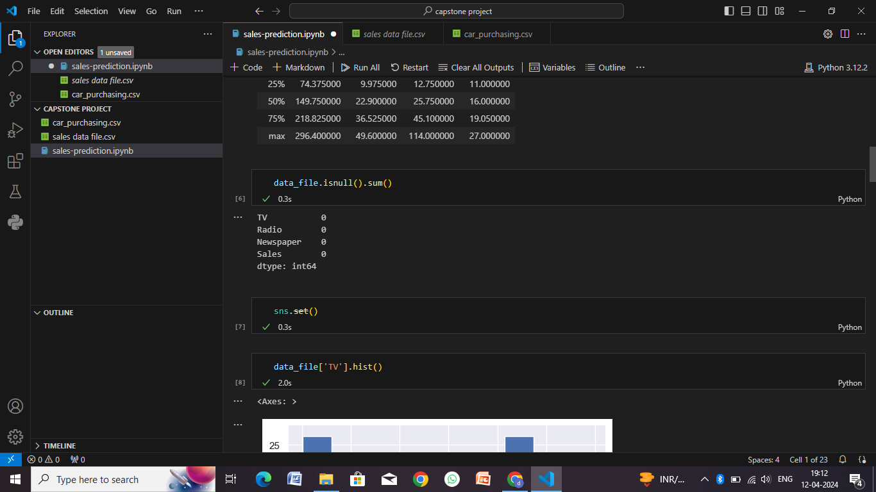

Slide 11
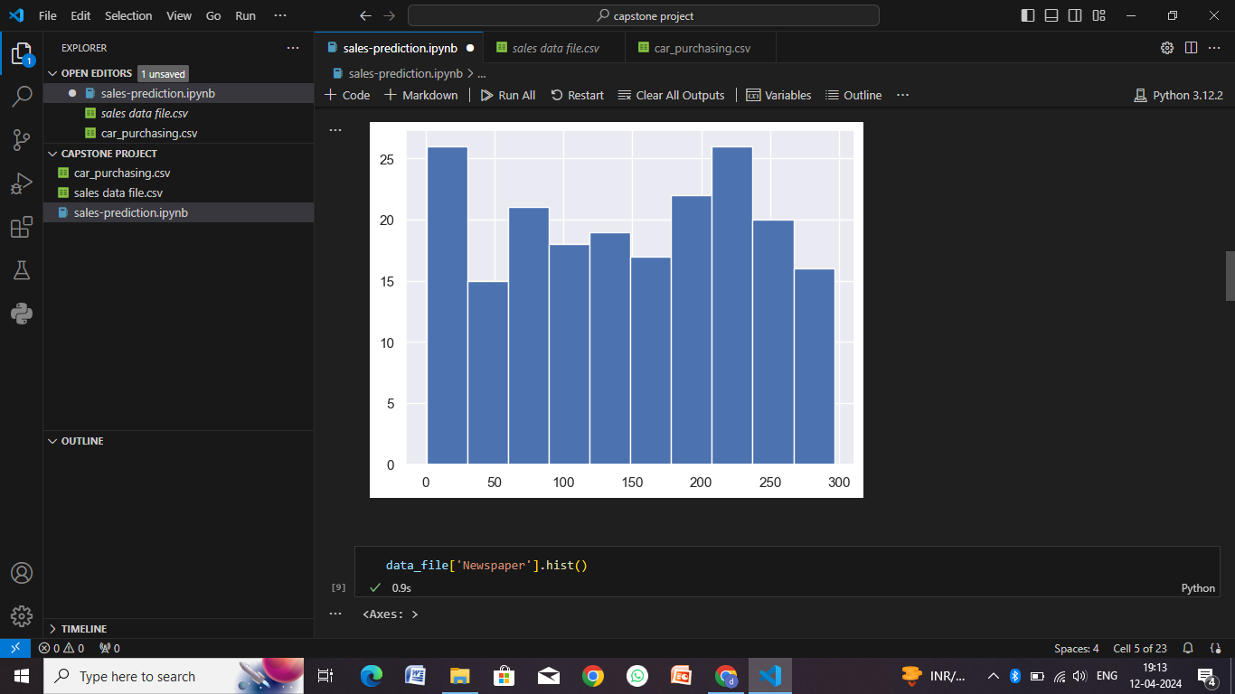

Slide 12
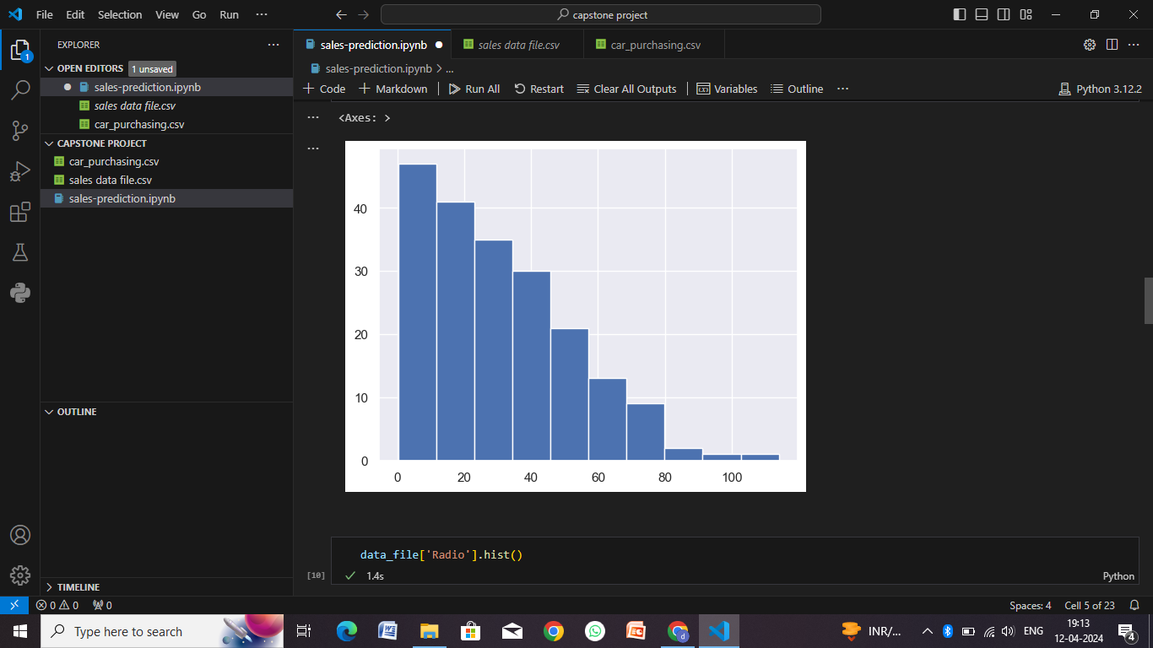

Slide 13
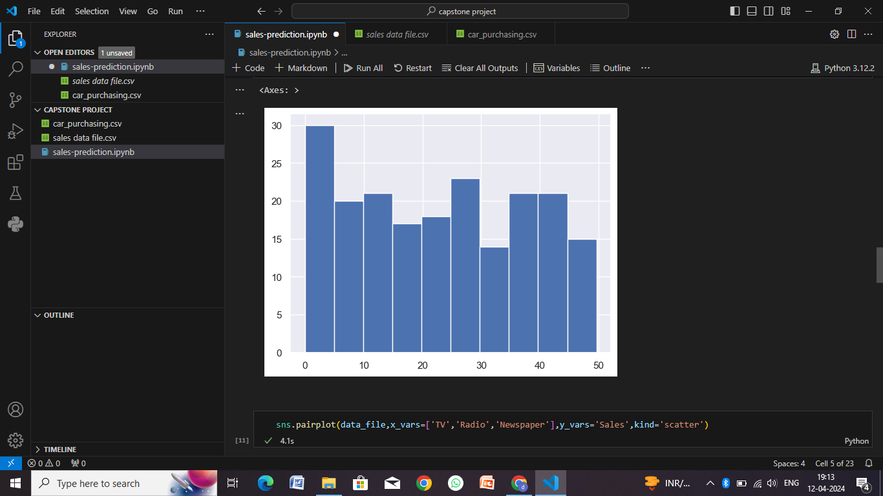

Slide 14
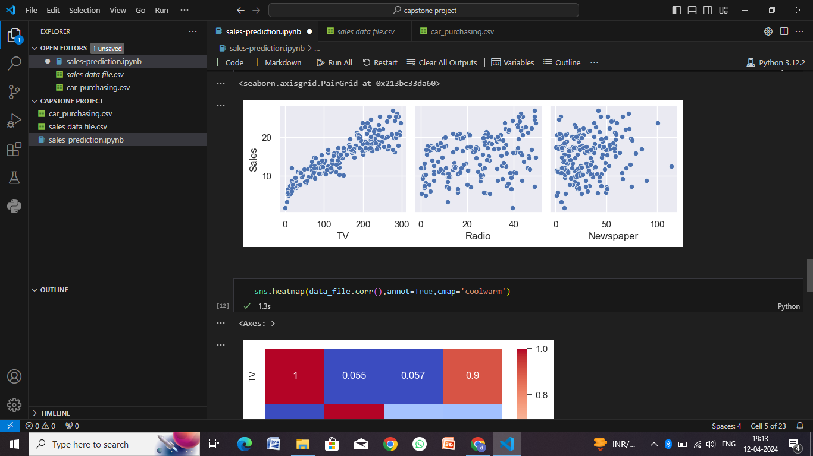

Slide 15
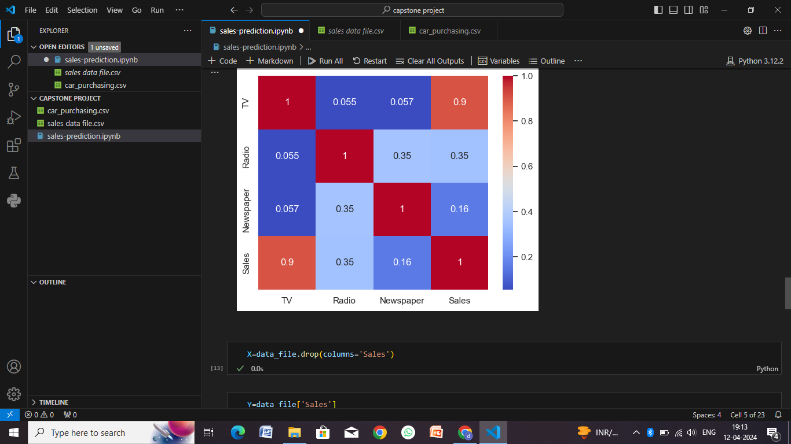

Slide 16
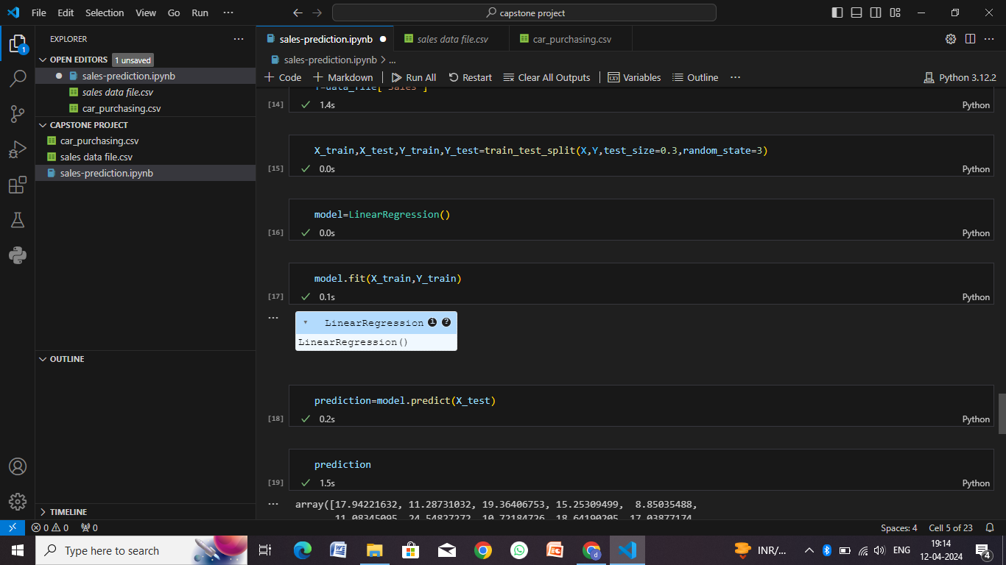

Slide 17
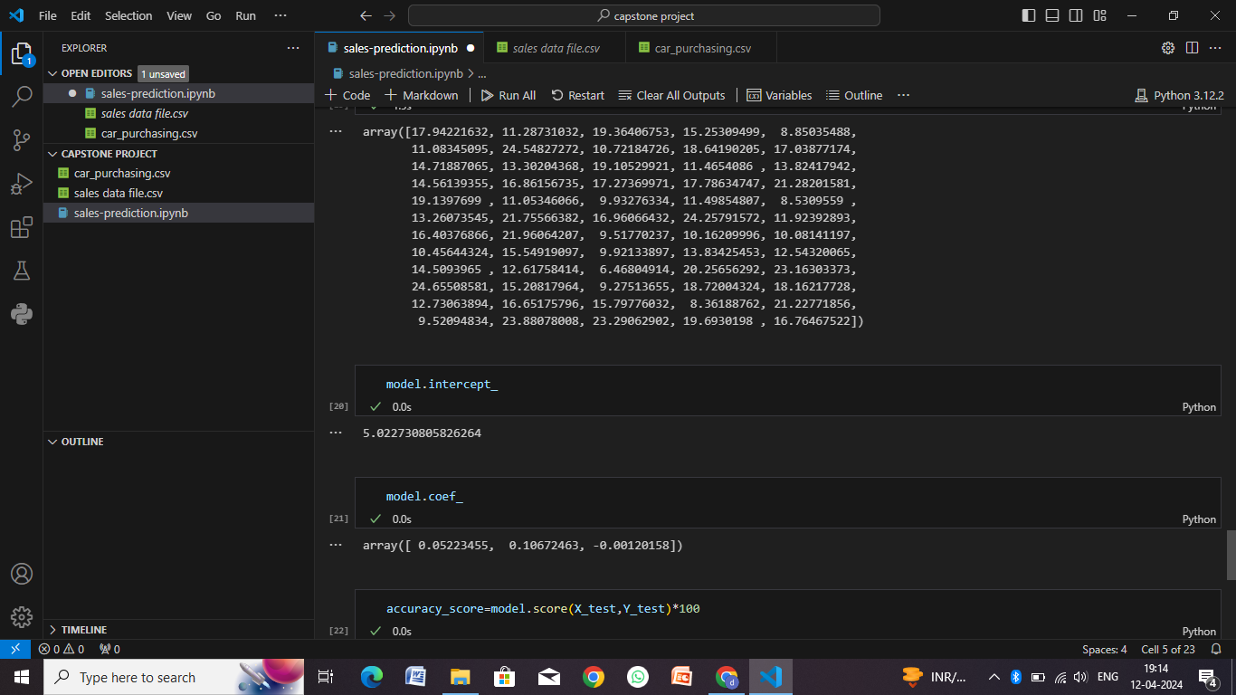

Slide 18
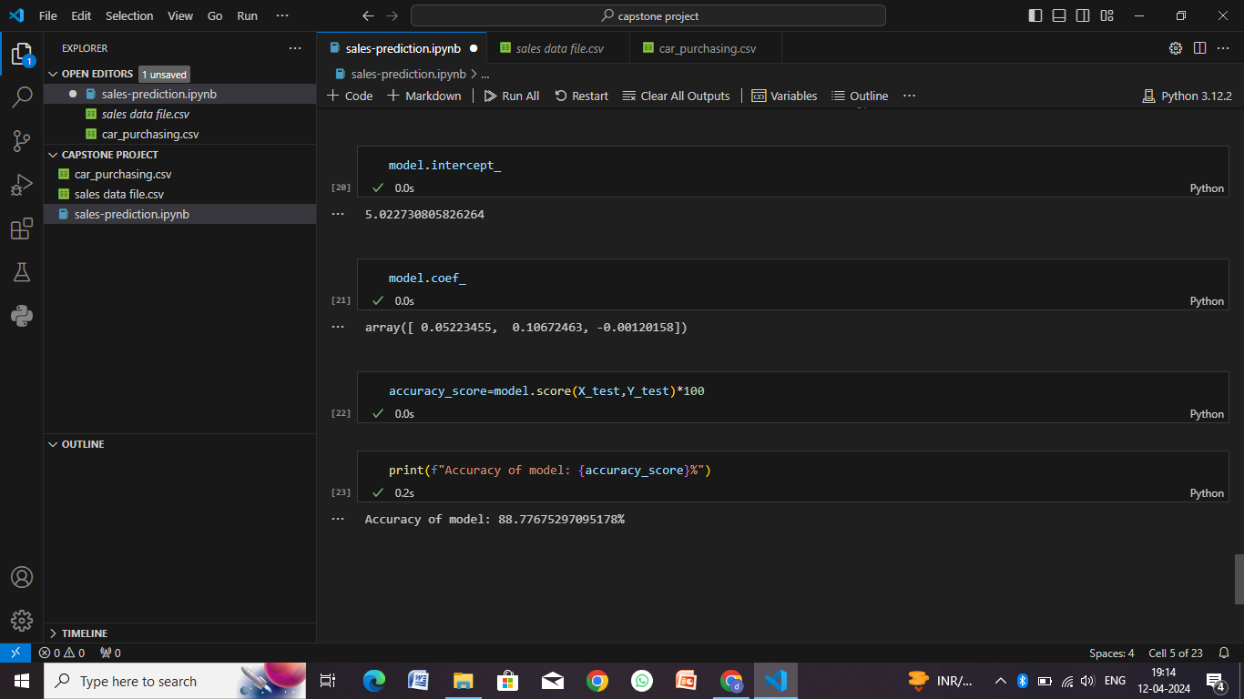

Slide 19
Conclusion
User-Centric Approach: The system should prioritize user experience by offering intuitive interfaces, advanced search and filtering options, and seamless communication between buyers and sellers.
Functionality: Key functionalities include user registration/authentication, car search and listing, secure payment processing, seller interaction, transaction management, and post-sale support.
Security: Implement robust security measures including user authentication, data encryption, secure payment gateways, and regular security audits to protect user information and transactions.
Deployment Considerations: Choose a scalable and reliable infrastructure, leverage containerization and load balancing for performance optimization, ensure database management and security, and implement monitoring/logging for system health and performance.
Continuous Improvement: Continuously gather user feedback, monitor system metrics, and iterate on features and functionalities to enhance the platform's usability, reliability, and overall value to users and stakeholders

Slide 20
Future scope
Artificial Intelligence (AI) Integration: Implement AI-driven features such as personalized recommendations based on user preferences, automated chatbots for customer support, and predictive analytics for market trends and pricing strategies.
Augmented Reality (AR) and Virtual Reality (VR): Integrate AR/VR technologies to offer immersive experiences for users, such as virtual car showrooms, interactive 3D models for car exploration, and AR-guided inspections during test drives.
Electric and Autonomous Vehicles: Adapt the platform to accommodate the growing market for electric vehicles (EVs) and autonomous vehicles (AVs), including specialized search filters, charging station integration, and AV-specific features for navigation and safety.
Sustainability and Green Initiatives: Incorporate sustainability-focused features such as carbon footprint calculators, eco-friendly vehicle ratings, and incentives for buyers/sellers of environmentally friendly cars.
Data Analytics and Machine Learning: Leverage data analytics and machine learning algorithms to gain insights into user behavior, market trends, pricing dynamics, inventory management, and demand forecasting, enabling data-driven decision-making and business optimization.

Slide 21
References
Books:
"Car Buying Revealed: How to Buy a Car and Not Get Taken for a Ride" by Brian Munroe
"The Complete Idiot's Guide to Buying or Leasing a Car" by Jack R. Nerad and Phil Edmonston
"Car Buying Tips from an Insider" by Mark Eskeldson
Websites and Online Resources:
Kelley Blue Book (www.kbb.com): Provides car pricing information, reviews, and guides for car buyers.
Edmunds (www.edmunds.com): Offers car reviews, pricing, and research tools for new and used cars.
Consumer Reports (www.consumerreports.org): Provides unbiased reviews, ratings, and buying advice for various consumer products, including cars.
National Highway Traffic Safety Administration (www.nhtsa.gov): Offers safety ratings, recalls, and other important information for car buyers.
Forums and Communities:
Reddit's r/askcarsales: A subreddit where you can ask questions and get advice from car sales professionals.
Automotive Forums (www.automotiveforums.com): An online community for discussing car buying, maintenance, and repairs.
Car Talk Community (community.cartalk.com): A forum for car enthusiasts to share advice and experiences related to car purchasing and ownership.

Slide 22
THANK YOU

